Slide 1
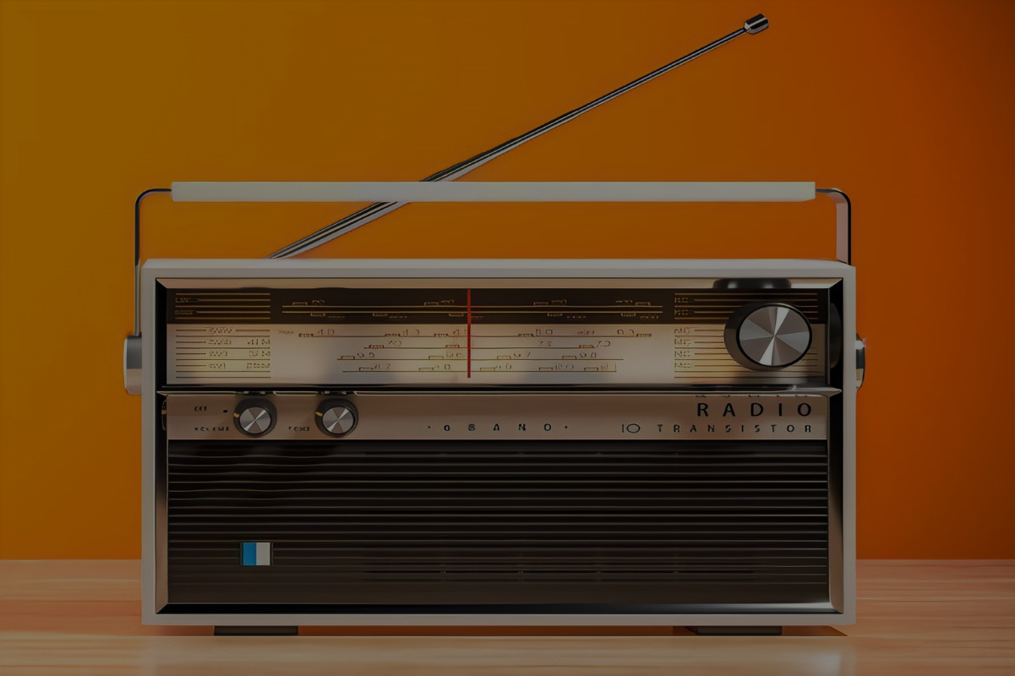

Slide 3
Radio is a way of transmitting messages over a distance by means of radio waves. It is also a field of science and technology related to the study of the physical phenomena underlying this method and its use for communication, sound broadcasting, image transmission, signaling, monitoring and control, detection and location of various objects, and for other purposes.

Slide 4
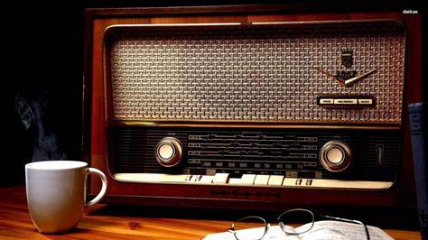
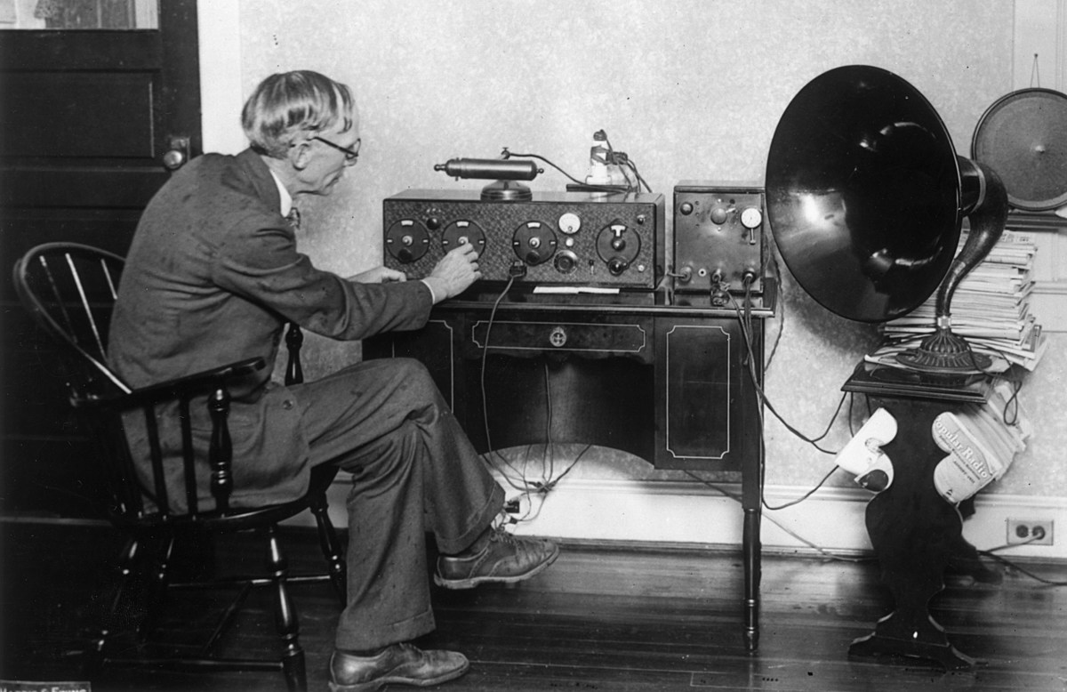
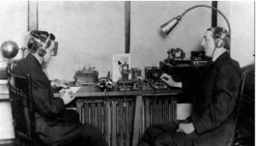
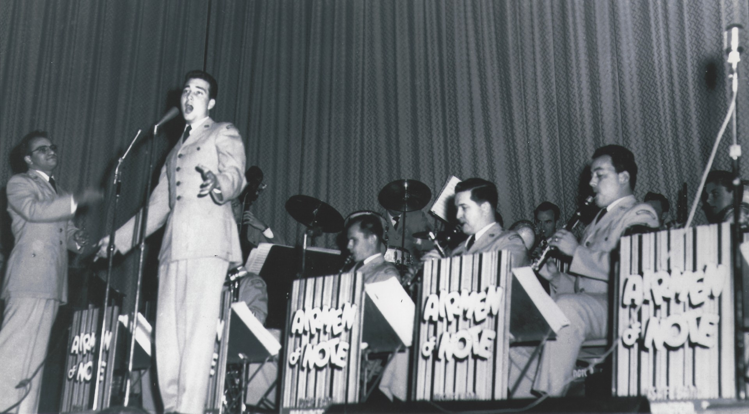
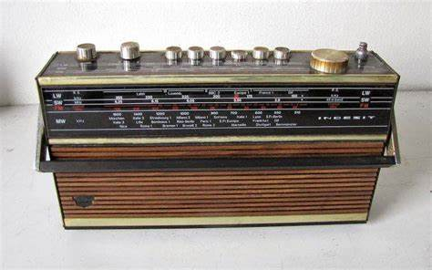
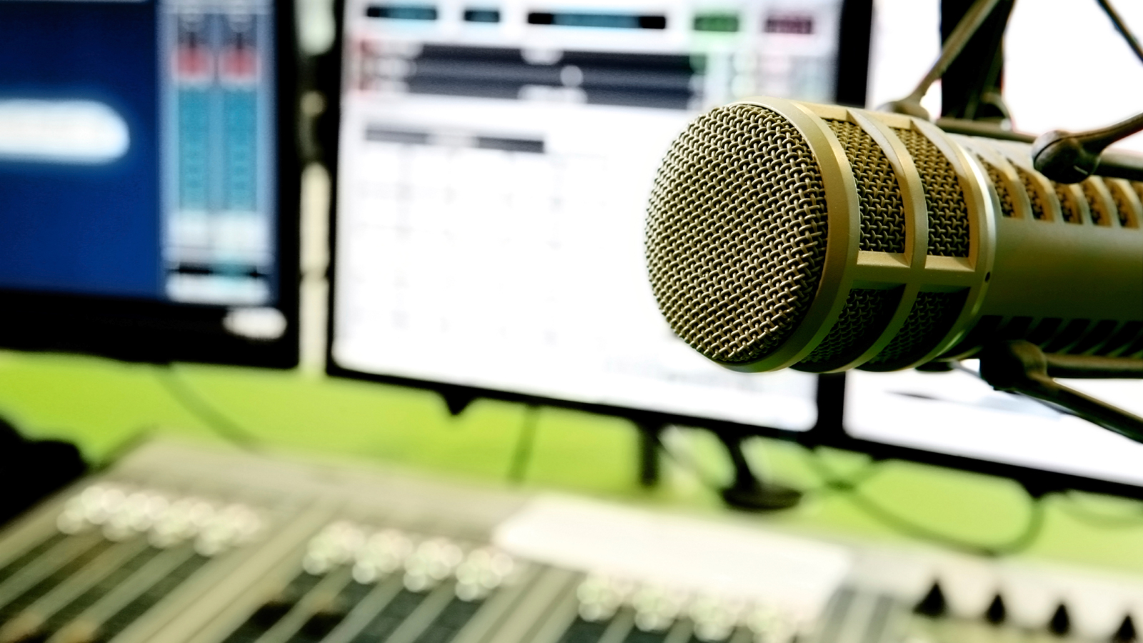
The Evolution of Broadcasting

Slide 5
The first steps in broadcasting
Radio broadcasting is the transmission of sound messages by means of radio to an unlimited number of listeners, one of the main means of operational information, mass agitation and propaganda, and public education.

Slide 6
The Early Days of Commercial Radio
In 1906, American Lee De Forest invented an audion, an electron-vacuum tube that made it possible to transmit voice messages, music, and noise effects. In 1908, Lee De Forest organized the first ever musical broadcast.

Slide 7
The Golden Era of Radio
The golden era of radio is a period in the history of radio broadcasting, which falls around 1920-1950. At this time, radio became a popular medium of media and entertainment that had a significant impact on society.

Slide 8
Development of technologies and standards
The years 1950-1960 were a period of significant changes in the development of technologies and standards in the field of broadcasting:
FM Radio: In the 1950s, American engineer Edward Armstrong made a revolutionary contribution to the development of radio broadcasting by creating a frequency modulation system. This signal transmission format provided better sound quality and became more resistant to interference than the previous AM standard. FM radio has become the standard for broadcasting music and high-quality programs.

Slide 9
The era of the Internet and digital radio
With the development of the Internet, it became possible to broadcast radio via the Internet. Internet radio has provided new opportunities for broadcasting and listening to audio content in real time anywhere in the world. People can listen to internet radio on computers, smartphones, tablets, and other devices.

Slide 10
The Role of Radio in Emergencies
01
02
03
04
Radio remains a reliable means of communication even in the event of accidents and natural disasters, when telephone networks and the Internet may not be available.
Радио остается надежным средством связи даже в случае аварий и природных катастроф, когда телефонные сети и интернет могут быть недоступны.
Радио остается надежным средством связи даже в случае аварий и природных катастроф, когда телефонные сети и интернет могут быть недоступны.
Радио остается надежным средством связи даже в случае аварий и природных катастроф, когда телефонные сети и интернет могут быть недоступны.

Slide 11
The Role of Radio in Emergencies
01
02
03
04
Radio remains a reliable means of communication even in the event of accidents and natural disasters, when telephone networks and the Internet may not be available.
Radios are often used to transmit emergency alerts and warnings to the public about impending dangers such as hurricanes, floods, fires, and earthquakes.
Радио остается надежным средством связи даже в случае аварий и природных катастроф, когда телефонные сети и интернет могут быть недоступны.
Радио остается надежным средством связи даже в случае аварий и природных катастроф, когда телефонные сети и интернет могут быть недоступны.

Slide 12
The Role of Radio in Emergencies
01
02
03
04
Radio remains a reliable means of communication even in the event of accidents and natural disasters, when telephone networks and the Internet may not be available.
Radios are often used to transmit emergency alerts and warnings to the public about impending dangers such as hurricanes, floods, fires, and earthquakes.
In emergency situations, radio communication allows rescue and emergency services to coordinate their actions, allocate resources and provide assistance to victims.
Радио остается надежным средством связи даже в случае аварий и природных катастроф, когда телефонные сети и интернет могут быть недоступны.

Slide 13
The Role of Radio in Emergencies
01
02
03
04
Radio remains a reliable means of communication even in the event of accidents and natural disasters, when telephone networks and the Internet may not be available.
Radios are often used to transmit emergency alerts and warnings to the public about impending dangers such as hurricanes, floods, fires, and earthquakes.
In emergency situations, radio communication allows rescue and emergency services to coordinate their actions, allocate resources and provide assistance to victims.
Radio stations provide important information about shelter locations, health posts, humanitarian aid distribution points, and other resources needed in the event of a disaster.

Slide 14
The Role of Radio in Emergencies
01
02
03
04
Radio remains a reliable means of communication even in the event of accidents and natural disasters, when telephone networks and the Internet may not be available.
Radios are often used to transmit emergency alerts and warnings to the public about impending dangers such as hurricanes, floods, fires, and earthquakes.
In emergency situations, radio communication allows rescue and emergency services to coordinate their actions, allocate resources and provide assistance to victims.
Radio stations provide important information about shelter locations, health posts, humanitarian aid distribution points, and other resources needed in the event of a disaster.

Slide 15

Thank you for your attention

Slide 16
Questions?

